Slide 1
US Border Database
ETL Project
Alex Black, Aaron Isaacson

Slide 2
Extract
Border Crossing Entry Data
Kaggle
Bureau of Transportation Statistics (BTS) compiled Customs and Border Protection (CBP) data of inbound crossings at the US-Canada and Mexico ports of entry
Data was well designed and maintained, required small edits to split columns and remove extraneous text
Country of Residence, Port of Entry Data
National Travel and Tourism Office (NTTO)
NTTO compiledI-94 data from the Department of Homeland Security , CBP, Canada’s International Travel Survey, and Instituto Nacional de Estadistica y Geografia to create a comprehensive count of all non-resident travelers entering the US
Data was clean and well designed, required minimal formatting edits to transpose data to compliment Border Crossing Data set

Slide 3
Transfer
Border Crossing Entry Data
CSV was well designed and maintained, required small edits to split columns and remove extraneous text
To clean:
Strip “US-”, “Border” from Border column
Change Date column format, strip time stamp
Split Location coordinates, create Latitude and Longitude columns
Country of Residence, Port of Entry Data
XLSX was clean and well designed, required minimal formatting edits to transpose data to compliment Border Crossing Data set
To clean:
Isolate annual data to columns and drop null values
Change column format from wide to long
Add new columns to data frame

Slide 4
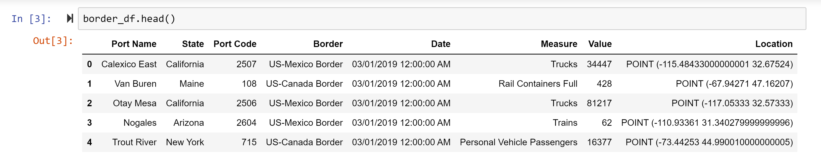
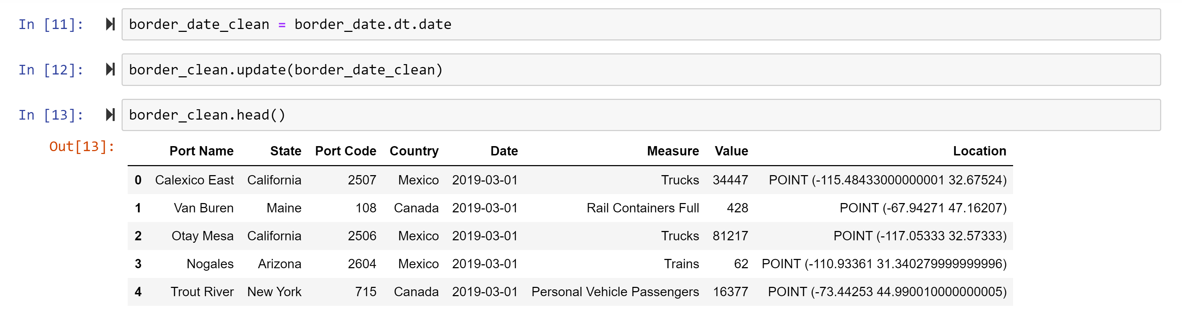
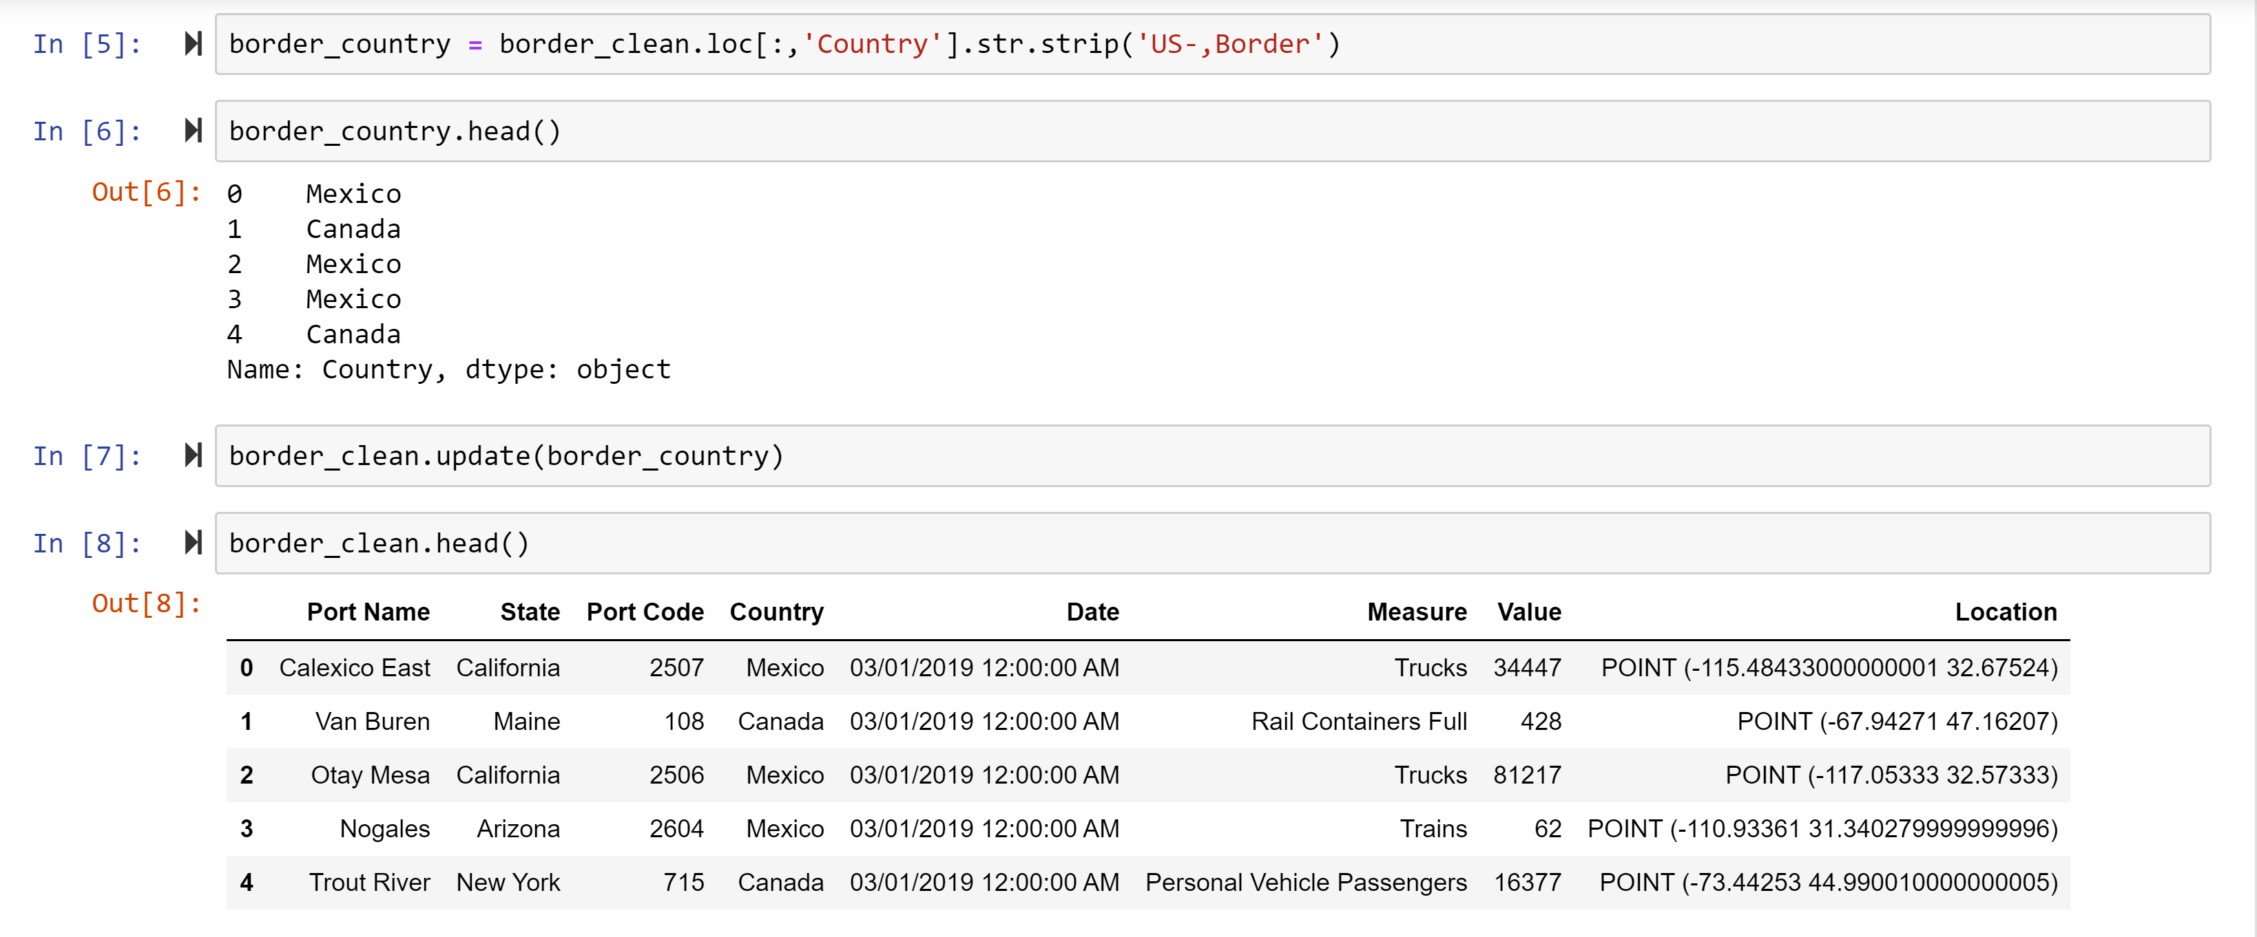
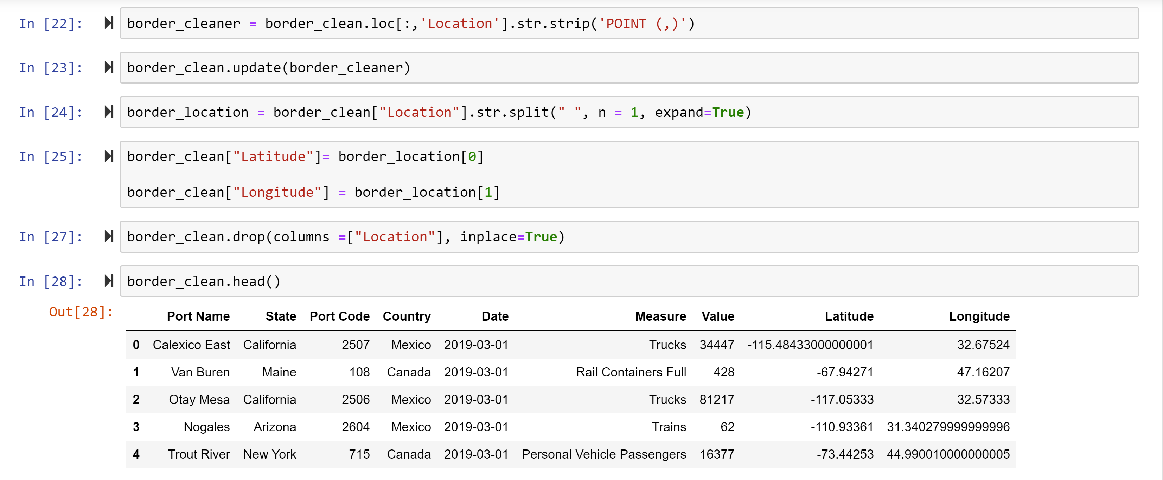
Border Crossing Data
Original CSV
Change date format, strip time stamp
Strip “US-”, “Border” from Border Column
Split location column to latitude and longitude

Slide 5
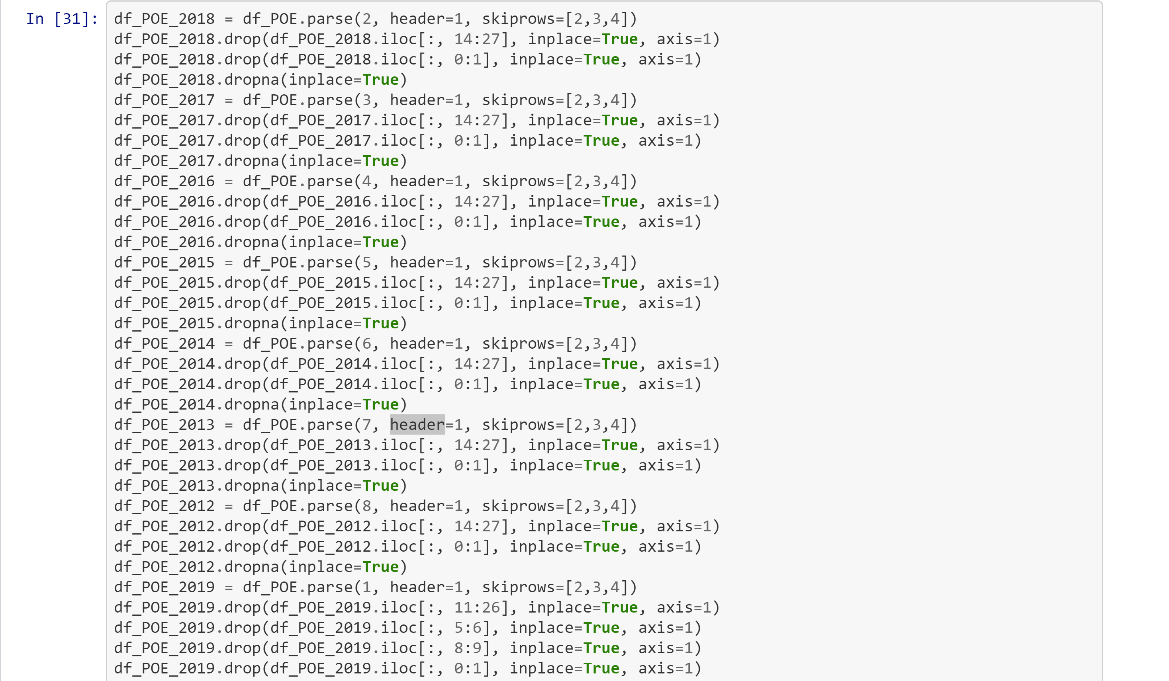
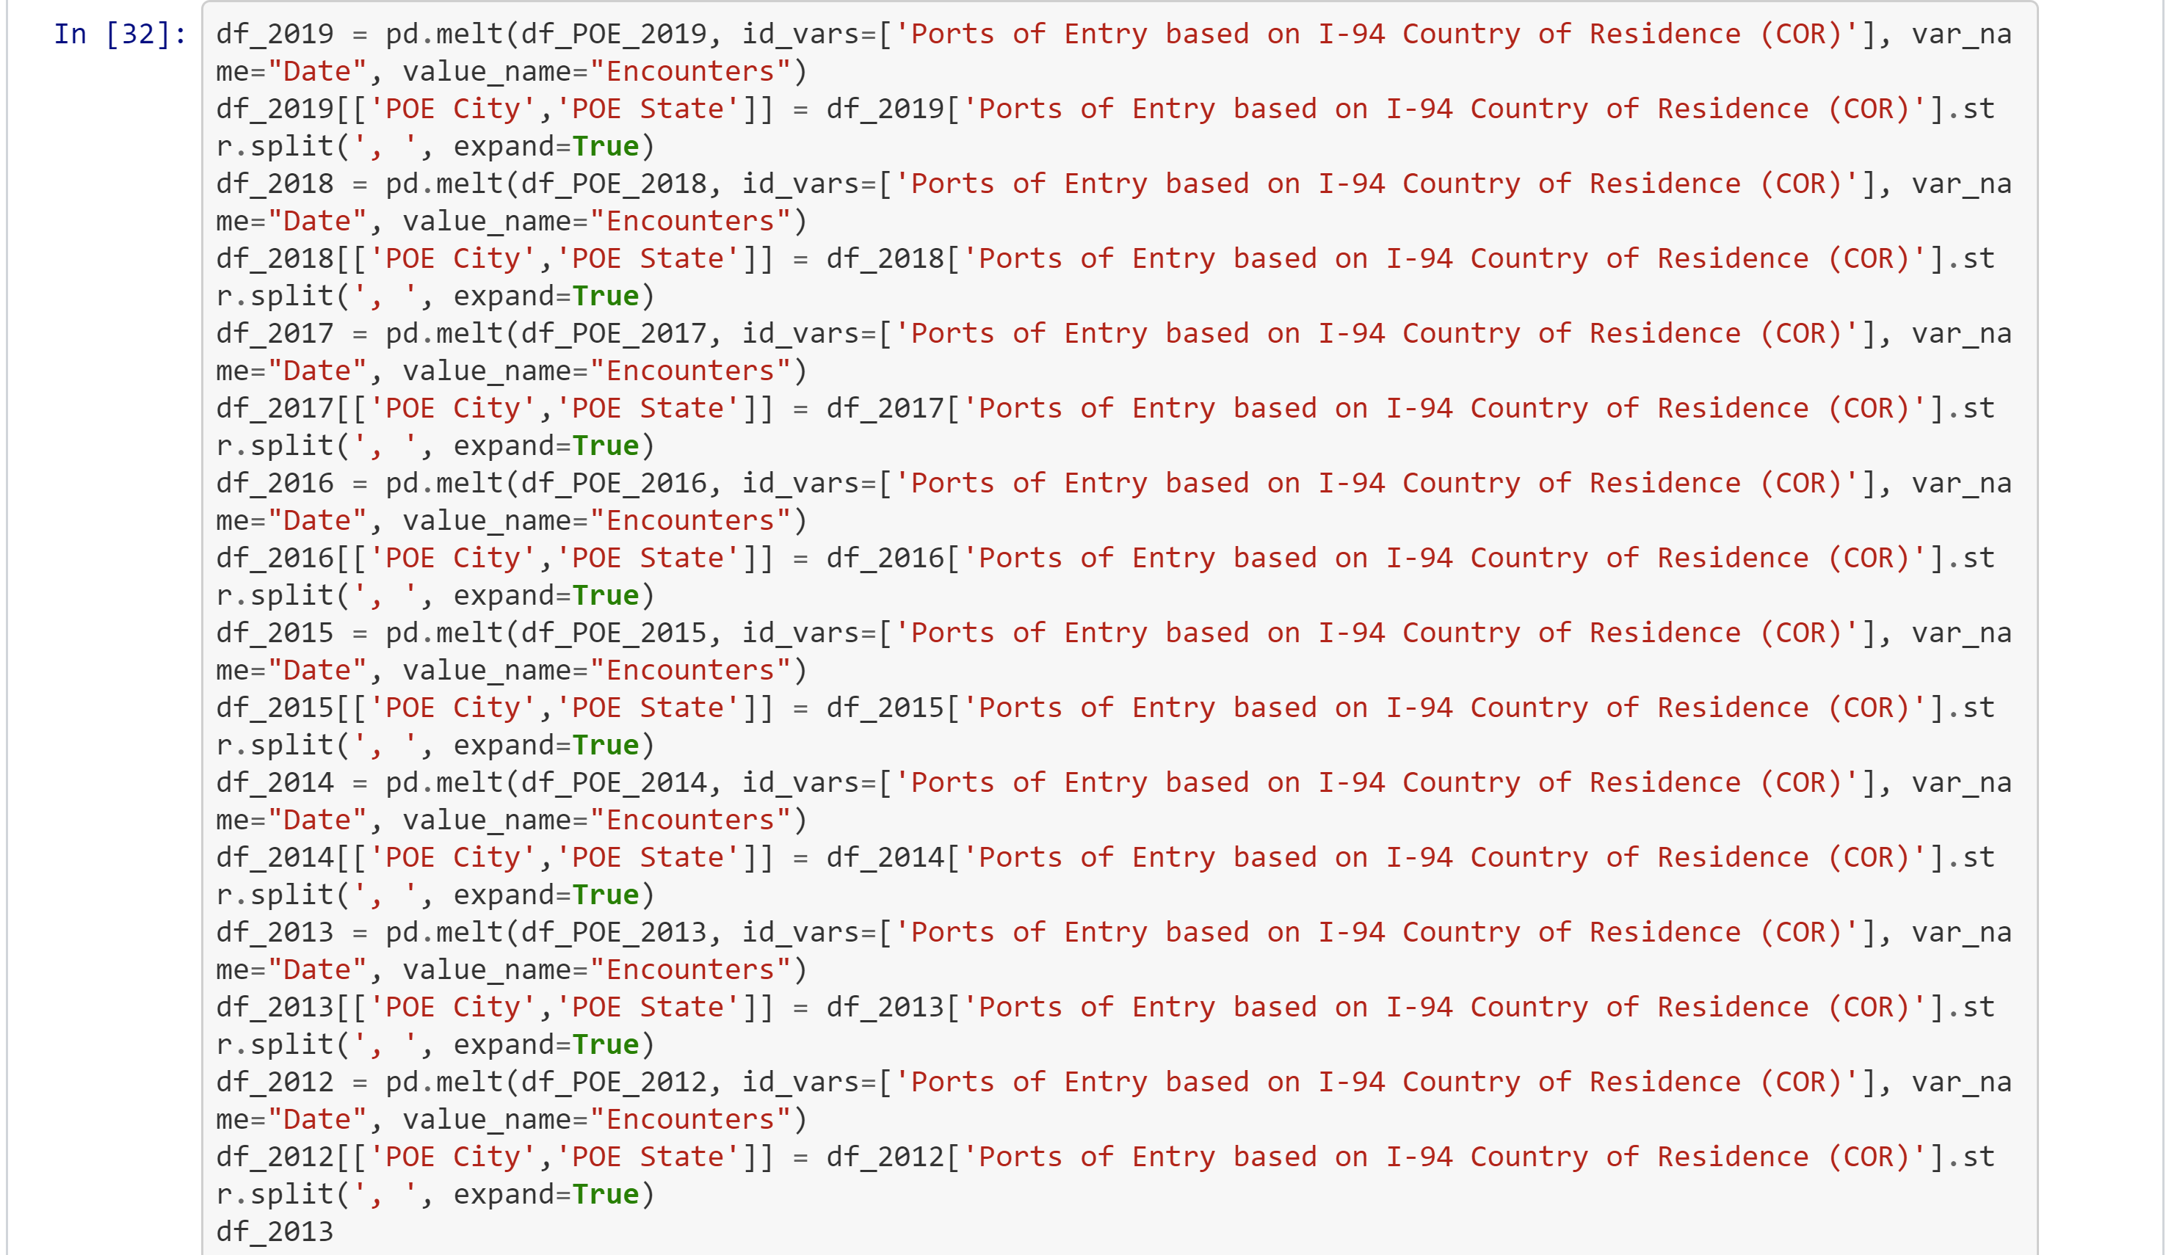
Port of Entry Data
Isolate data to columns and drop null values
Change column format from wide to long
Add new columns to data frame

Slide 6
Load
Deploy data to AWS database using the SQL Alchemy in Python
Include full data sets from Customs and Border Patrol, and National Travel and Tourism Office
Port of entry data captures the full amount of inbound travel in to the US from neighboring North American countries
Data also captures the overlap in inbound travel volume from immigration vs. tourism
Use of full data sets allows end user to see relationships in inbound travel by POE state, city, and date

Slide 7
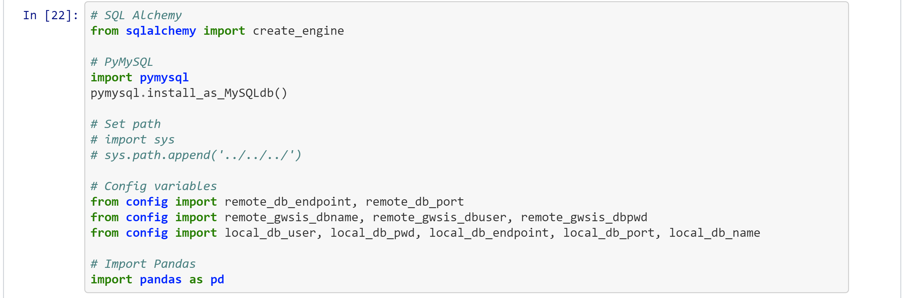
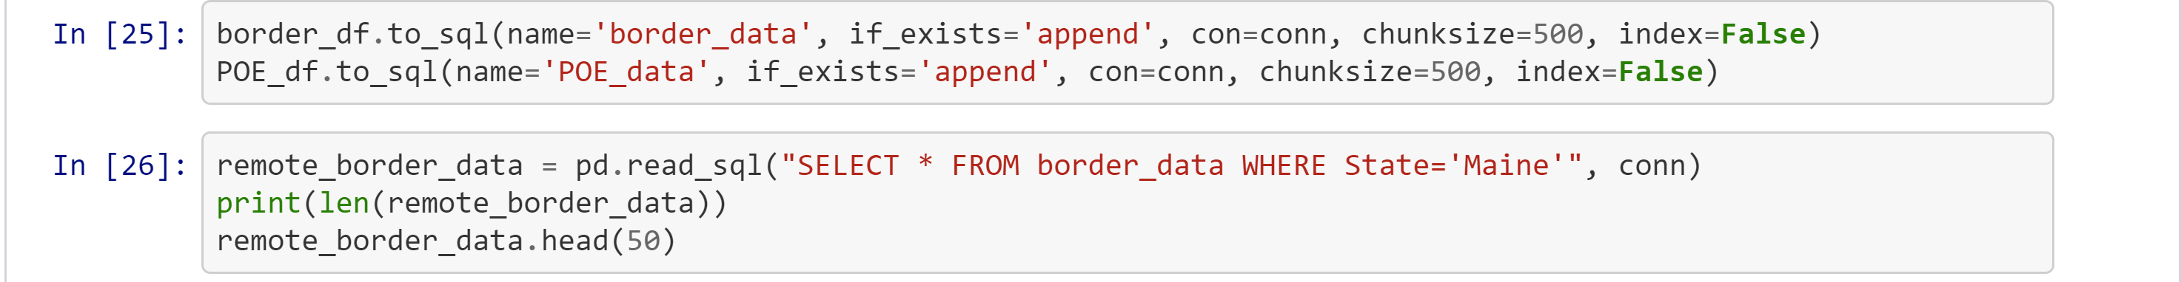
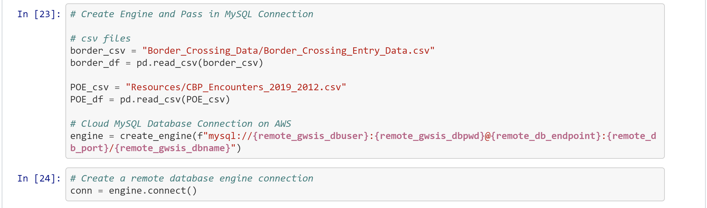
Load
Import SQL Alchemy and Config File
Read files in to SQL, Verify
Import CSV Files and Initialize Database Connection

